Slide 1
Utilizing Data Mining Techniques to Enhance Learner's Emotional Intelligence and Academic Attainment
Santhosh Kumar Nanubala
SID: 11488046 MSc Data Science and CI

Slide 2
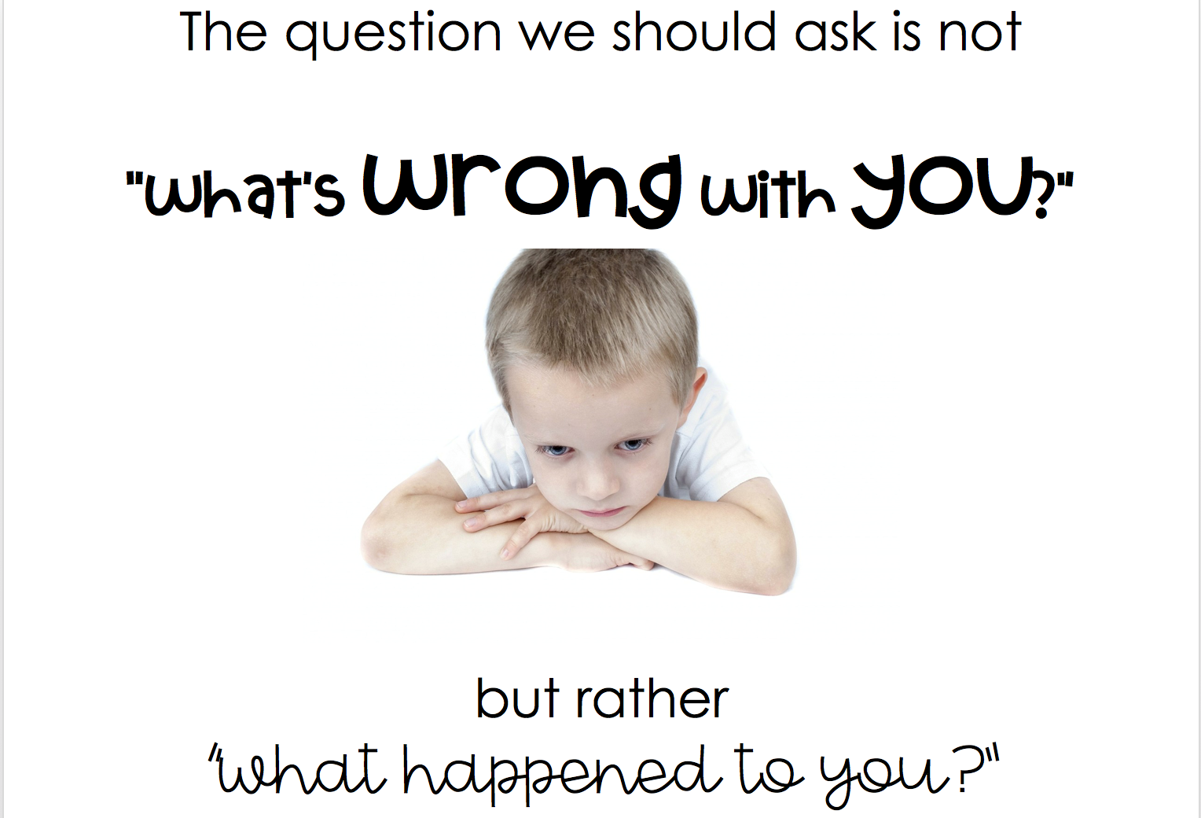

Slide 3
Outline
Introduction
Research Question & Aim and Objectives
Problem Statement & Topic for Investigation
Intended Users
Literature Review
Gantt Chart
Design & Methodology
Implementation
Results and Summary
References

Slide 4
What is social & emotional Learning and why is it important?
Social-emotional learning (SEL) is a form of learning that incorporates social and emotional skills into the curriculum. It is a crucial component of the education system and social evolution. SEL is the process by which all teenagers and grown ups obtain and implement the wisdom, abilities, and perceptions needed to construct healthy personalities, express feelings, accomplish self and social aspirations, perceive and feel compassion for others, build lasting positive interactions, and end up making respectful and trustworthy choices.
Both youngsters and grownups benefit from SEL, which increases self-awareness, academic achievement, and prosocial feelings within and beyond the curriculum. Academically, learners who engaged in SEL programs improved their total marks by 11 percentage points and had higher punctuality.

Slide 5
Research Question & Aim and Objectives
Research Question:
How effectively Data Mining Algorithms and Statistical Analysis can be used to enhance the Emotional Intelligence (EI) and Academic Attainment of Learners?
How Emotional Intelligence affects the Learners Academic attainment?
Aim:
Examine how to improve learner’s emotional intelligence and academic accomplishment utilizing data mining techniques.
Objectives:
The core objective is to make learning with an emotionally driven paradigm feasible in a variety of learning environments.
Design an effective data mining techniques that assist learners to enhance their academics proficiency and emotional intelligence.
Utilizing statistical analysis, anticipate the impacts of social and emotional learning on learners' personal and educational growth.

Slide 6
Problem Statement & Topic for Investigation
Emotions and social relations are part of our life. SEL (social and emotional learning) is a crucial component of education and social evolution (James et al., 2019). Social and emotional learning is a process of acquiring self-awareness, self-restraint, and social skills that are necessary for academic, professional, and personal success (Jagers et al., 2019). The envisioned project's goal is to make learning with an emotionally driven paradigm viable in a variety of learning environments (James et al., 2019). (Allbright et al., 2019) Significant techniques that emotional intelligence is supposed to use to achieve change in the learner’s academic accomplishment is the primary research gap that will be filled in this study. This also uses certain well-known data mining algorithms and statistical analysis to assess and compare the results.

Slide 7
Intended Users
Intended user or group of users: educational institutions, students or learners, teachers, peers or Colleagues, Families and Learner’s social & emotional relations.
Learner's benefit from social and emotional learning because it teaches them essential survival abilities such as personality, building a strong subconscious, embracing responsibility for one's actions, and building interactions with everyone (Panayiotou, M., et al., 2019).
Youngsters can benefit from the concept of SEL. Improves stability, resilience, dedication, compassion, commitment and enthusiasm to school, and a feeling of purpose are all examples of more progressive outcomes towards self, colleagues, and assignments (Jones-Schenk, J. 2019). Reduced mischief and risk-taking attitude. Emotional anguish is reduced. Educational Institutions who follow the concept can gain more admissions (Mielke, M. and Farrington, D. P. 2021). Academically, learners who engaged in SEL programs improved their total grades by 11 percentiles and had higher attendance (Xia, J et al., 2022). According to research, SEL is more successful when families replicate the same competences that their children are learning in class. More beneficial social habits and improvement of adult and peer connections (Arikan, N. 2020).

Slide 8
Literature Review
According to (Jan, S. U., & Anwar, M. A. 2019) EI has indeed been discovered to be a one-of-a-kind reliable indicator of academic accomplishment in learners. It assists them in making the journey from secondary school to higher educational institutions. Because there is a link between EI and learners' academic achievement. Research findings revealed that learners who stayed at university exhibited much higher levels of emotional and social acumen than those who dropped out before one‘s second year. Academic performance causes a slew of issues that might negatively impact a learner’s academic success. EI was one of the elements that contributed to this form of procrastinate.
Based on the Researchers (Zhoc, K. C., et al., 2020) have looked at the influence of emotions on learner involvement. In education, nevertheless, very little recognized over how emotional intelligence (EI) is linked to involvement and other effective learning results. To bridge that gap, this research examined over how emotional intelligence (EQ) is linked to learner involvement and how EQ and involvement work together to forecast important and vital objectives in education, such as learners' Grades, general results, and happiness with their educational journey.

Slide 9
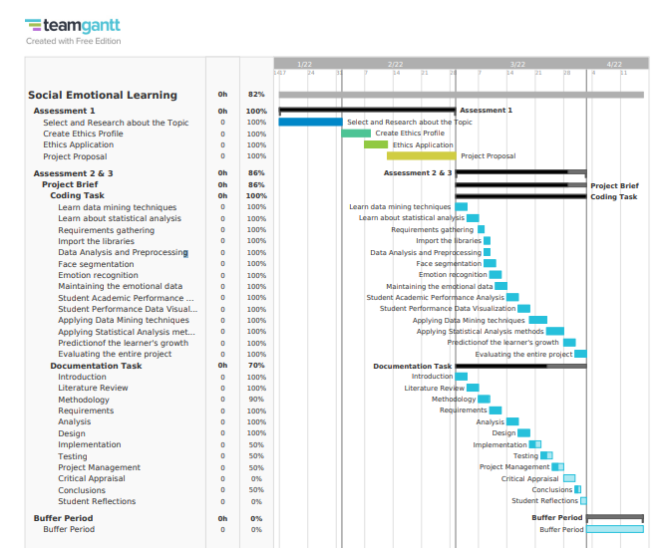
Gantt Chart

Slide 10
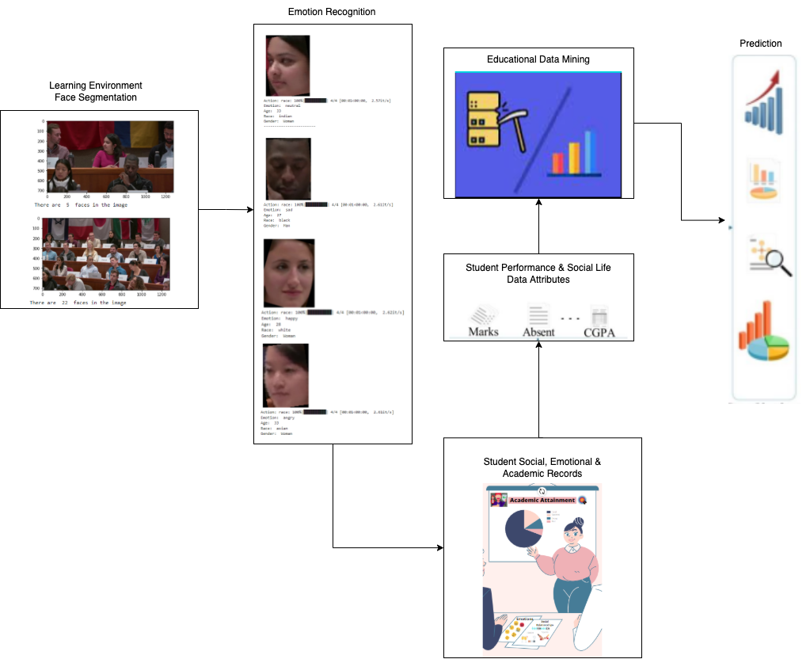
Design and Methodology: Educational Data mining approach for social-emotional learners

Slide 11
Implementation
Data is gathered from Kaggle (https://www.kaggle.com/mahjabeenamira/classroom-images, https://www.kaggle.com/larsen0966/student-performance-data-set)
Data is of 2 types – Classroom Images, Student performance data.
Initially Classroom Images data is loaded.
With the help of Deepface, Retinaface, cv2 the following processes are achieved Face segmentation, Emotion recognition.
Maintained the emotional data.
Loaded the required libraries and student performance data.
Data preprocessing (removing duplicates, null, Nan) is employed.
In the student performance data, 3 different exam grades are available. Created an average of all the 3 grades and inserted as a new column. From these Grade the students based on the average. Fail is considered based on below 40% which is below 8. The ranges are: Fail - (0, 8], Third - (8, 10], Lower Second - (10, 13], Upper Second - (13, 16], First - (16, 20].

Slide 12
Implementation
Statistical analysis of data is done using statsmodels.api for descriptive statistics and performed some inferential statistics.
Data Preparation is done by encoding the whole data using onehot encoder and label encoder.
Selected classification (‘Logistic Regression’, ‘Decision Tree Classifier (ID3, C4.5)’, ‘Support Vector Machine’, ‘Random Forest Classifier’, ‘AdaBoost Classifier’, ‘Gradient Boosting Classifier’, ‘K Neighbors Classifier’, ‘Gaussian Naive Bayes’), clustering (Agglomerative Clustering), and regression (Linear Regression) models.
As the dataset is small employed smote, random under sampling and random over sampling.
Employed hyperparameter tuning for all the classification models.
Divided the data set into train and test with 80:20 ratio.
Evaluated the built models by utilizing Confusion matrix, Accuracy, Precision, Recall, F1 score.
Random Forest & Gradient Boosting seem to give the best results.
SVM, Logistic Regression, Gaussian Naive Bayes probably overfits the data, since there are only 649 rows and 31 columns, for this number of features there’s a need for more data for the built models to fit properly.
ID3, C4.5 seems to give the best results in comparison with decision tree.
Clustering and regression models are not suitable for this kind of dataset.

Slide 13
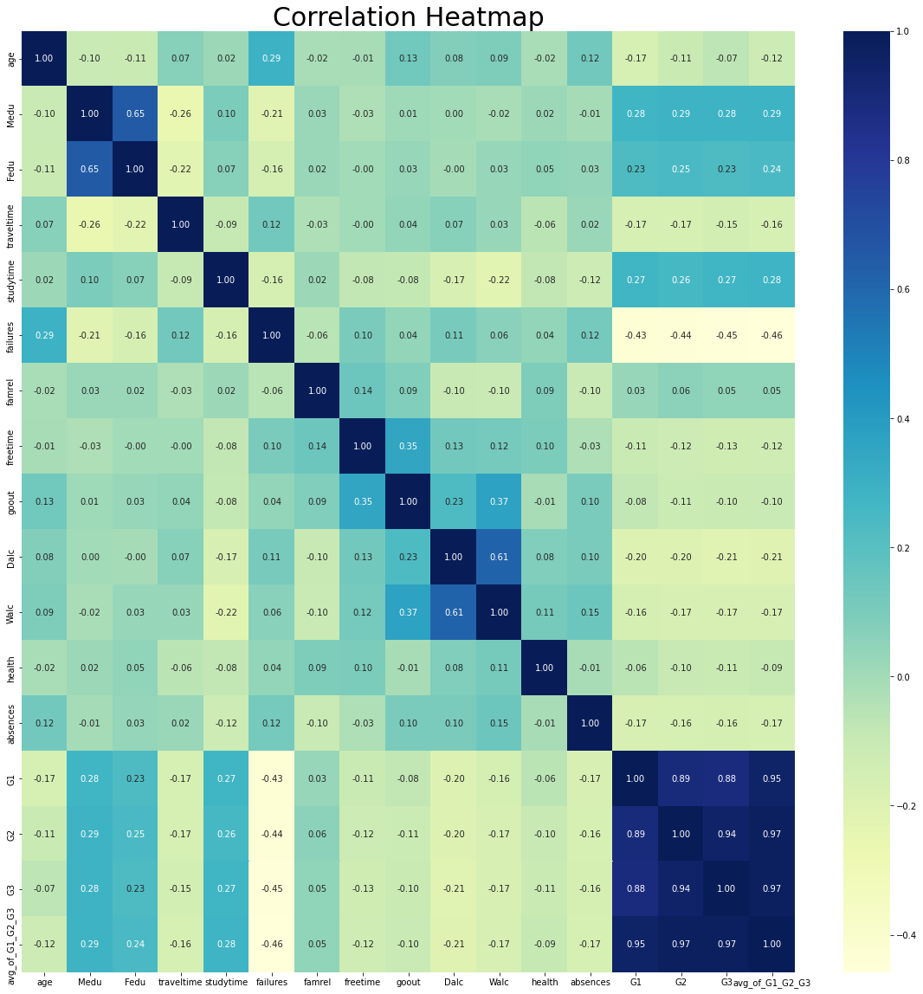
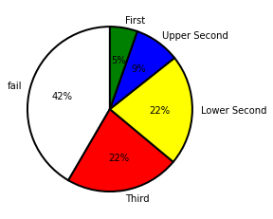

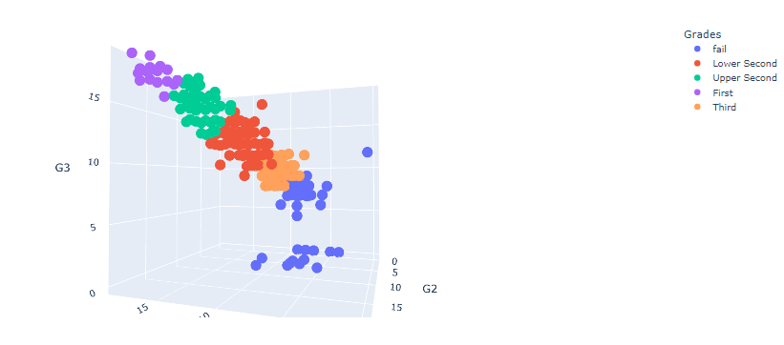
EDA Results

Slide 14
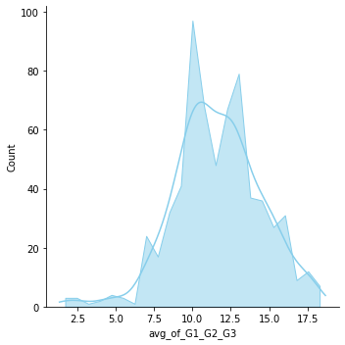
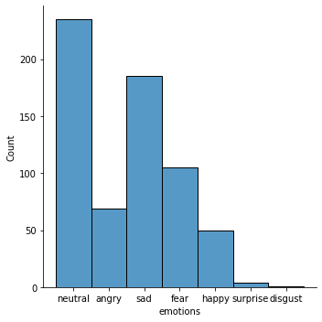
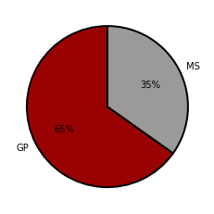
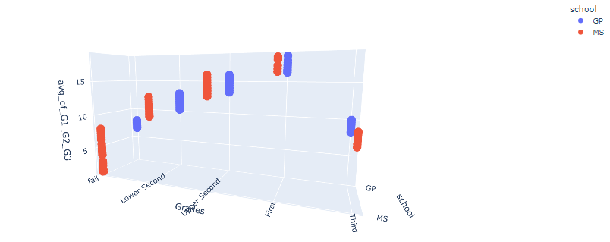
EDA Results

Slide 15
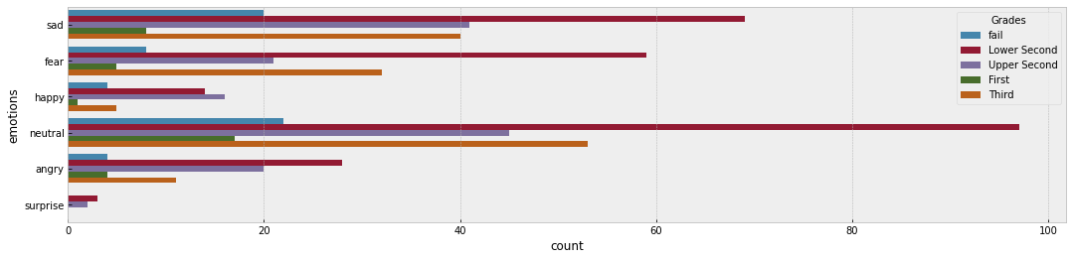
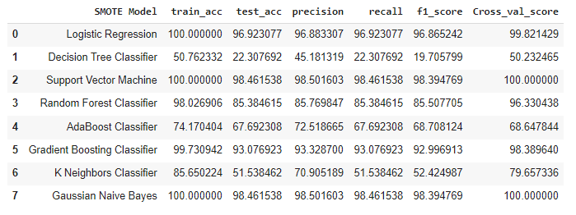
Results

Slide 16
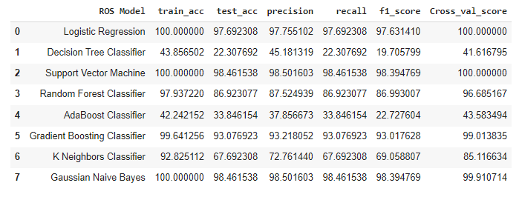
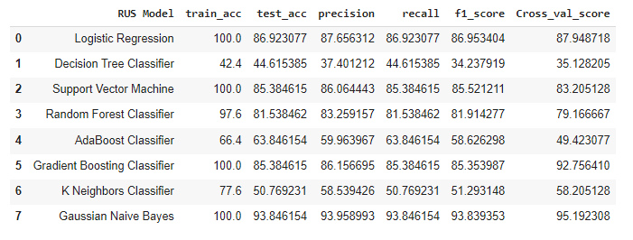
Results
ID3 Testing accuracy: 0.9307692307692308 ID3 Training accuracy: 1.0
C4.5 Testing accuracy: 0.9307692307692308 C4.5 Training accuracy: 1.0

Slide 17
Summary
A lot of researchers have been undertaken to discover several elements namely the student academic aspect, the personal aspect, the family aspect, and the teacher aspect for learner’s academic attainment. Many criteria, or combinations of aspects, influence learner achievement, which varies from one nation to another, one organization to another, one community to another, and one set of learners to the next. In this case, the learners social and emotional data is crucial. The learner's social and emotional data must be more engaged with the learner, providing correct direction and motivating the learner. According to the findings of various research, emotional intelligence and data mining methods are important assets for enhancing learner’s academic attainment prediction. According to research, SEL is not just to enhances performance by 11 percent on average, but also enhances interpersonal skills (such compassion, sharing, and empathy), enhance learning academic competence, and decreases sadness & anxiety among children. It demonstrated that emotional intelligence and data mining may be leveraged in institutions to forecast learners' academic results. The goal of overall research investigations is to employ data mining methods and emotional intelligence to detect learner academic attainment.

Slide 18
References
James, I.Samuel Peter & Ramasubramanian, Perumal. (2019). Emotional Intelligence Based Learning On The Academic Attainment of Learners And Assessment Using Data Mining Algorithms. Caribbean Journal of Science. 53. 379-392.
Allbright, T. N., Marsh, J. A., Kennedy, K. E., Hough, H. J., and McKibben, S. (2019) 'Social-Emotional Learning Practices: Insights from Outlier Schools'. Journal of Research in Innovative Teaching & Learning
Jagers, R. J., Rivas-Drake, D., and Williams, B. (2019) 'Transformative Social and Emotional Learning (SEL): Toward SEL in Service of Educational Equity and Excellence'. Educational Psychologist 54 (3), 162-184
Jones-Schenk, J. (2019) 'Social and Emotional Learning: Why does it Matter?'. The Journal of Continuing Education in Nursing 50 (2), 57-58
Zhoc, K. C., King, R. B., Chung, T. S., & Chen, J. (2020). Emotionally intelligent students are more engaged and successful: Examining the role of emotional intelligence in higher education. European Journal of Psychology of Education, 35(4), 839-863.
Jan, S. U., & Anwar, M. A. (2019). Emotional intelligence, library use and academic achievement of university students. Journal of the Australian Library and Information Association, 68(1), 38-55.

Slide 19

Q&A

